Slide 1

Superstore
Relational
Database
Design

Slide 2
Project Agenda
1. Business Background
Business
Background
Story
2. Creating ER Model
3. Creating ERD
4. Creating Relational DB
5. 3NF Normalization
6. Further Implementation

Slide 3
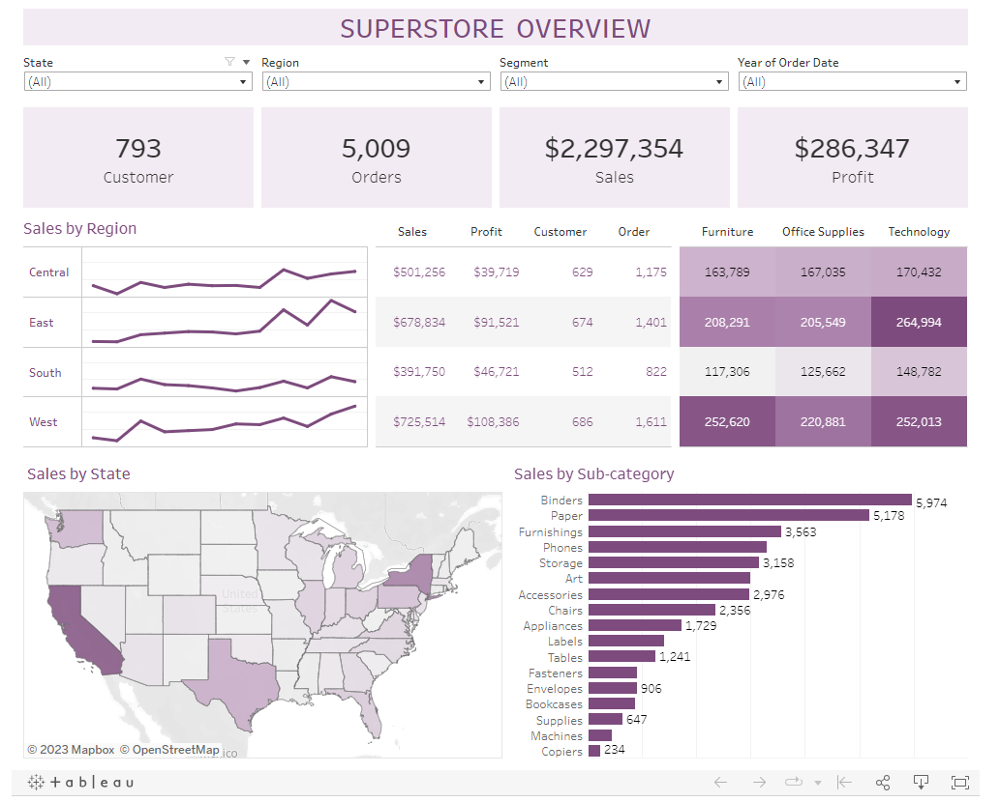
Business Background
Superstore is an e-commerce website, covering a wide range of categories of products across the United States' geography.
Superstore shares their data online and the dataset is famous for data visualization and data analysis practice.
As their business volume gradually expands, the existing data storage method can no longer meet their needs.

Slide 4
Business Objectives
Demands:
A Superstore Giant is seeking help to redesign its data storage structure.
They need more efficient storage and retrieval system as volumes surge.
They need easy manipulation methods for daily use and further analysis.
Objectives: Building a relational database for Superstore
Meets 3NF Standards
Retains Original Information
Simplifies Data Structure
Implements Flexible Queries

Slide 5
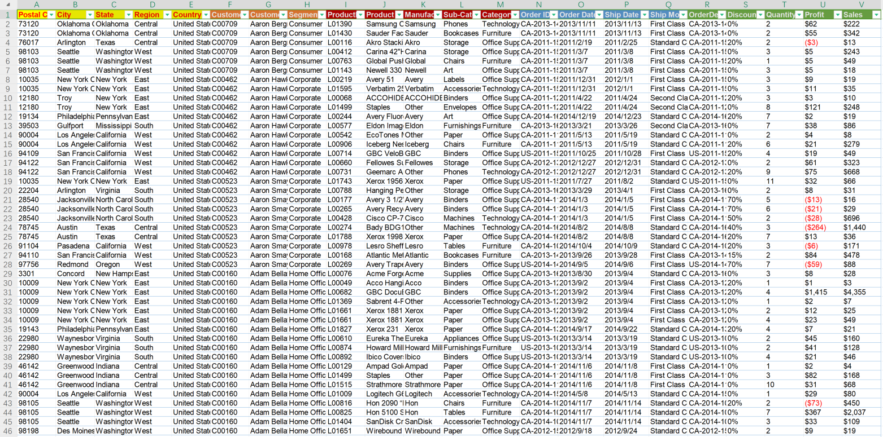
Business Background
Each row indicates one item within an order.

Slide 6
Project Agenda
1. Business Background
Entity
Relationship
Model
2. Creating ER Model
3. Creating ERD
4. Creating Relational DB
5. 3NF Normalization
6. Further Implementation

Slide 7
Creating ER Model -- Entities
Each row should include 5 clusters of information.
Each cluster could be a table within the database.
What
When
Who
Where
Product
Order
Customer
Location
How much
Order_item

Slide 8
Creating ER Model – Entities Connection
What
Product
When
Order
Order_item
Who
Where
How much
Customer
Location

Slide 9
Creating ER Model – Relationship1
Product to Order_item Relationship:
A Product may belong to one or more Orders_items.
Each Order_item must have one and only one Product.
Product.ProductID (PK) --> Order_item.ProductID (FK)

Slide 10
Creating ER Model – Relationship2
Order to Order_item Relationship:
An Order may have one or more Orders_items.
Each Order_item must belong to one and only one Order.
Order.OrderID (PK) --> Order_item.OrderID (FK)

Slide 11
Creating ER Model – Relationship3
Customer to Order Relationship:
A Customer may have one or more Orders.
Each Order must belong to one and only one Customer.
Customer.CustomerID (PK) --> Order.CustomerID (FK)

Slide 12
Creating ER Model – Relationship4
Location to Order Relationship:
A PostalCode may belong to one or more Orders.
Each Order must have one and only one PostalCode.
Location.PostalCode (PK) --> Order.PostalCode (FK)

Slide 13
Project Agenda
1. Business Background
Entity
Relationship
Diagram
2. Creating ER Model
3. Creating ERD
4. Creating Relational DB
5. 3NF Normalization
6. Further Implementation

Slide 14
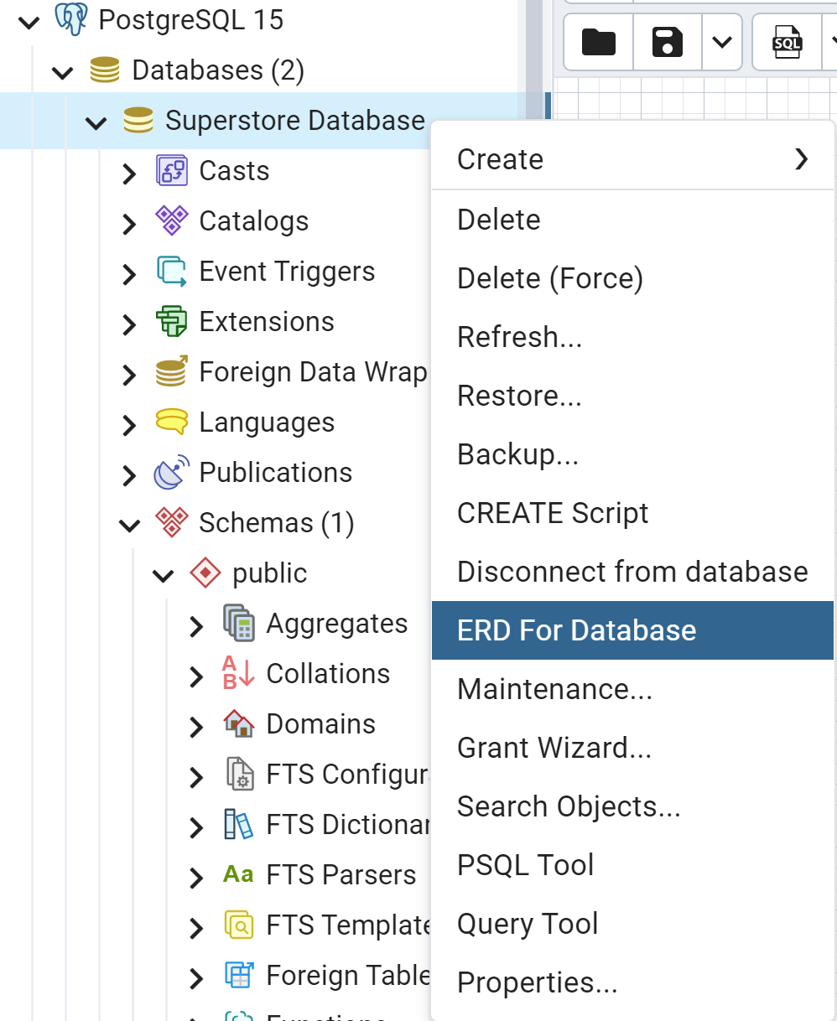
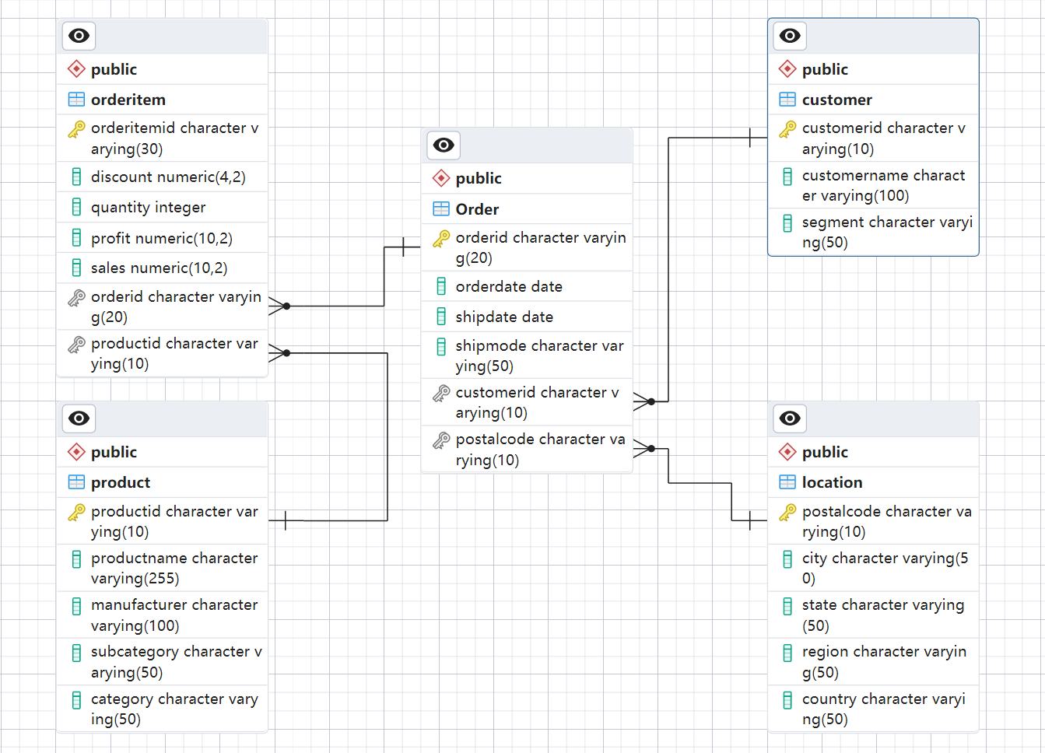
Creating ERD

Slide 15
Project Agenda
1. Business Background
Relational
Database
Design
2. Creating ER Model
3. Creating ERD
4. Creating Relational DB
5. 3NF Normalization
6. Further Implementation

Slide 16
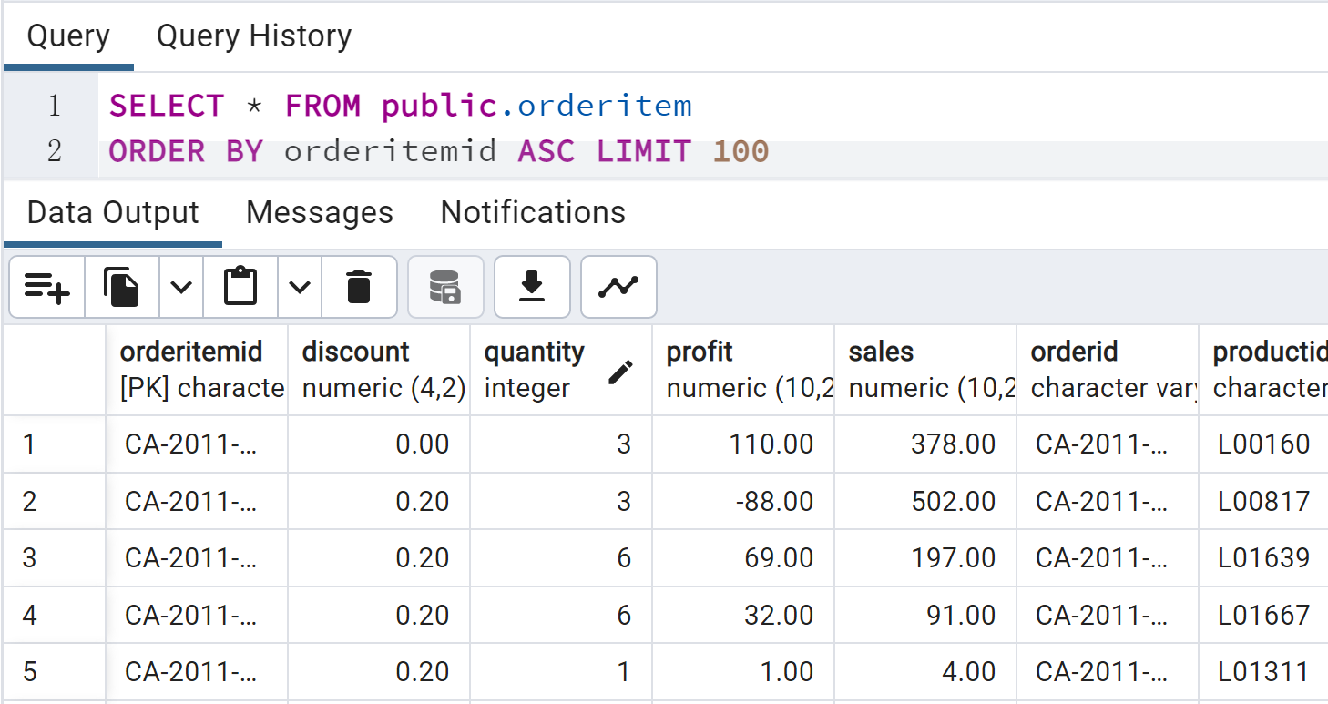
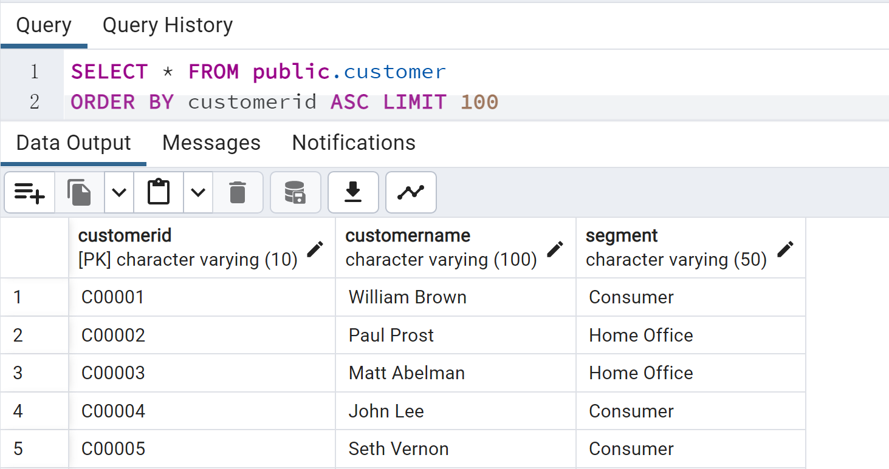
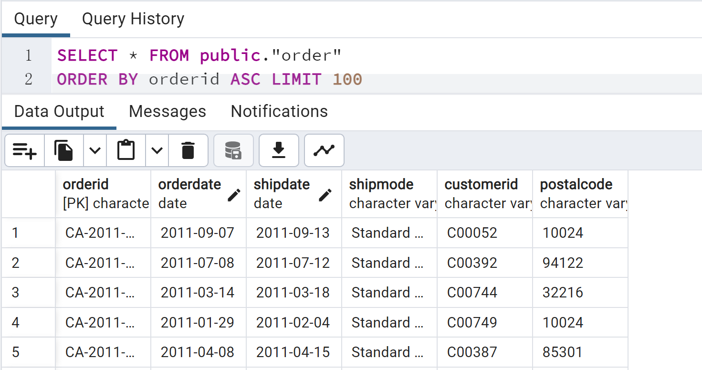
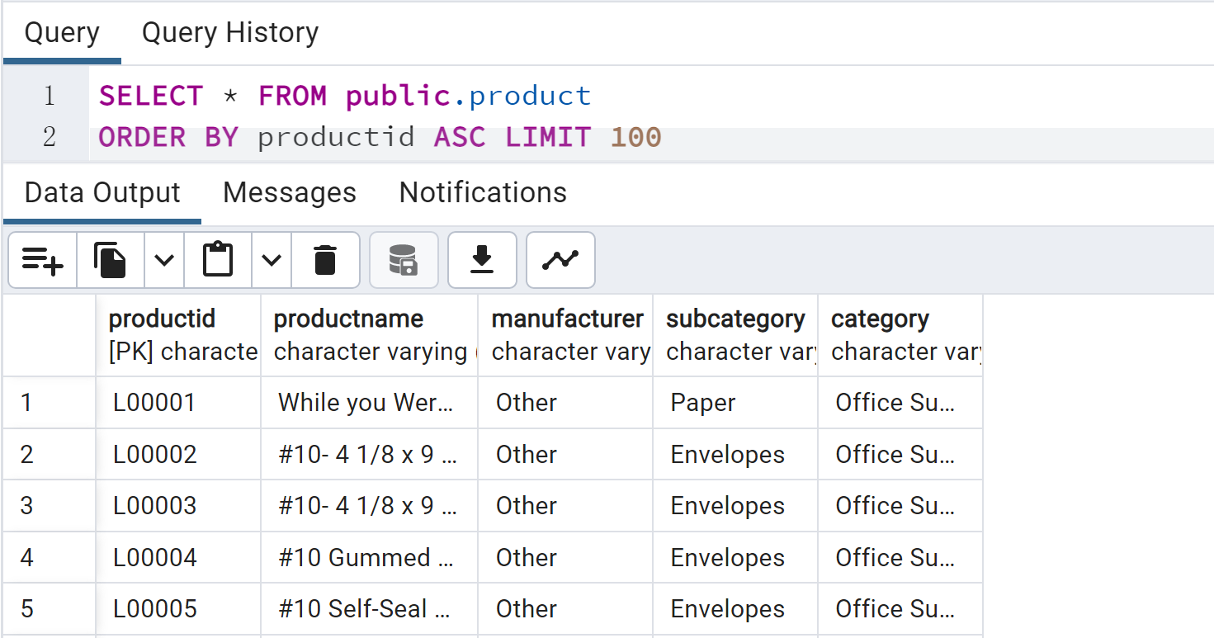
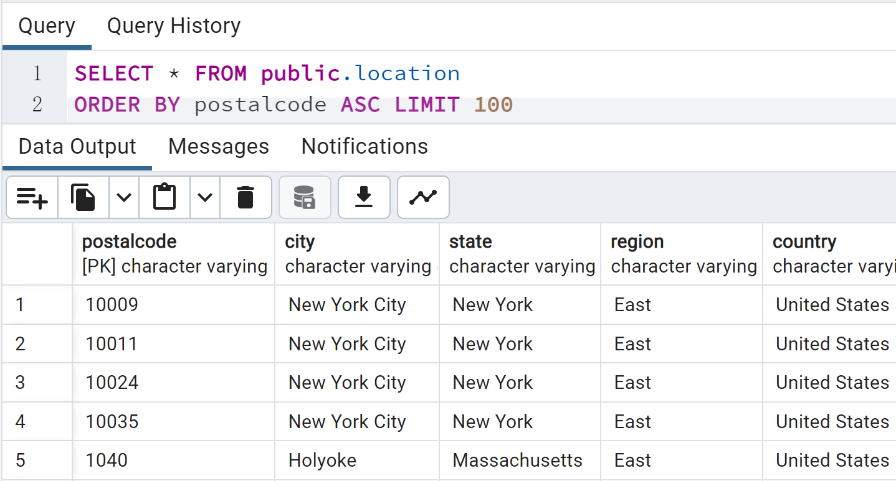
Creating Relational DB

Slide 17
Project Agenda
1. Business Background
Third
Normal
Form
2. Creating ER Model
3. Creating ERD
4. Creating Relational DB
5. 3NF Normalization
6. Further Implementation

Slide 18
3NF Normalization
Customer, Location, Order, and OrderItem relations are in 3NF
There is no partial functional and no transitive functional dependencies.
Customer (CustomerID, CustomerName, Segment)
FD1: CustomerID → CustomerName, Segment
Location (PostalCode, City, State, Region, Country
FD1: PostalCode → City, State, Region, Country
Order (OrderID, OrderDate, ShipDate, ShipMode, CustomerID(FK), PostalCode(FK))
FD1: OrderID → OrderDate, ShipDate, ShipMode, CustomerID(FK), PostalCode(FK)
OrderItem (OrderItemID, Discount, Quantity, Profit, Sales, OrderID(FK), ProductID(FK))
FD1: OrderItemID → Discount, Quantity, Profit, Sales, OrderID(FK), ProductID(FK)

Slide 19
3NF Normalization
Product is in 2NF and there is no partial functional dependencies.
Product is not in 3NF since there is transitive functional dependencies.
Product (ProductID, ProductName, Manufacturer, SubCategory, Category
FD1: ProductID → ProductName, Manufacturer, SubCategory, Category
FD2: SubCategory → Category
Create a new relation to put SubCategory → Category
Category (SubCategory, Category)
FD1: SubCategory → Category
Product (ProductID, ProductName, Manufacturer, SubCategory)
FD1: ProductID → ProductName, Manufacturer, SubCategory

Slide 20
Project Agenda
1. Business Background
Applications
2. Creating ER Model
3. Creating ERD
4. Creating Relational DB
5. 3NF Normalization
6. Summarization

Slide 21
Summarization
Final Relational Model in 3NF
Customer (CustomerID, CustomerName, Segment
FD1: CustomerID → CustomerName, Segment)
Location (PostalCode, City, State, Region, Country
FD1: PostalCode → City, State, Region, Country
Order (OrderID, OrderDate, ShipDate, ShipMode, CustomerID(FK), PostalCode(FK)
FD1: OrderID → OrderDate, ShipDate, ShipMode, CustomerID(FK), PostalCode(FK)
OrderItem (OrderItemID, Discount, Quantity, Profit, Sales, OrderID(FK), ProductID(FK)
FD1: OrderItemID → Discount, Quantity, Profit, Sales, OrderID(FK), ProductID(FK)
Category (SubCategory, Category)
FD1: SubCategory → Category
Product (ProductID, ProductName, Manufacturer, SubCategory)
FD1: ProductID → ProductName, Manufacturer, SubCategory

Slide 22
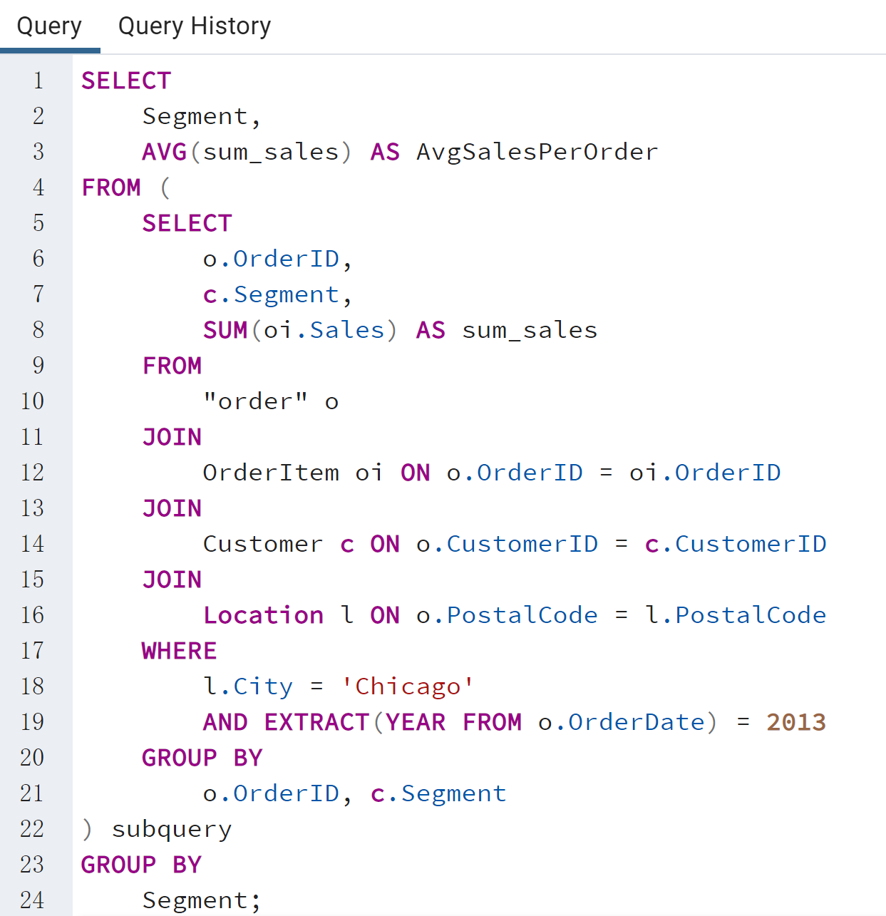
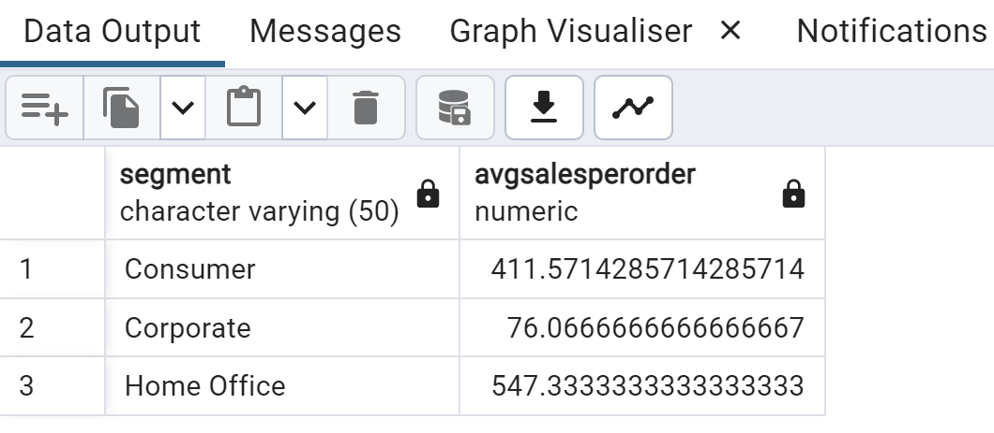
Calculate the average sales per order in Chicago in the year 2013, grouped by customer segment.
The result is correct!
The structure is understandable!
The queries are easily adaptable!

Slide 23
Thanks
for Watching

